Slide 1
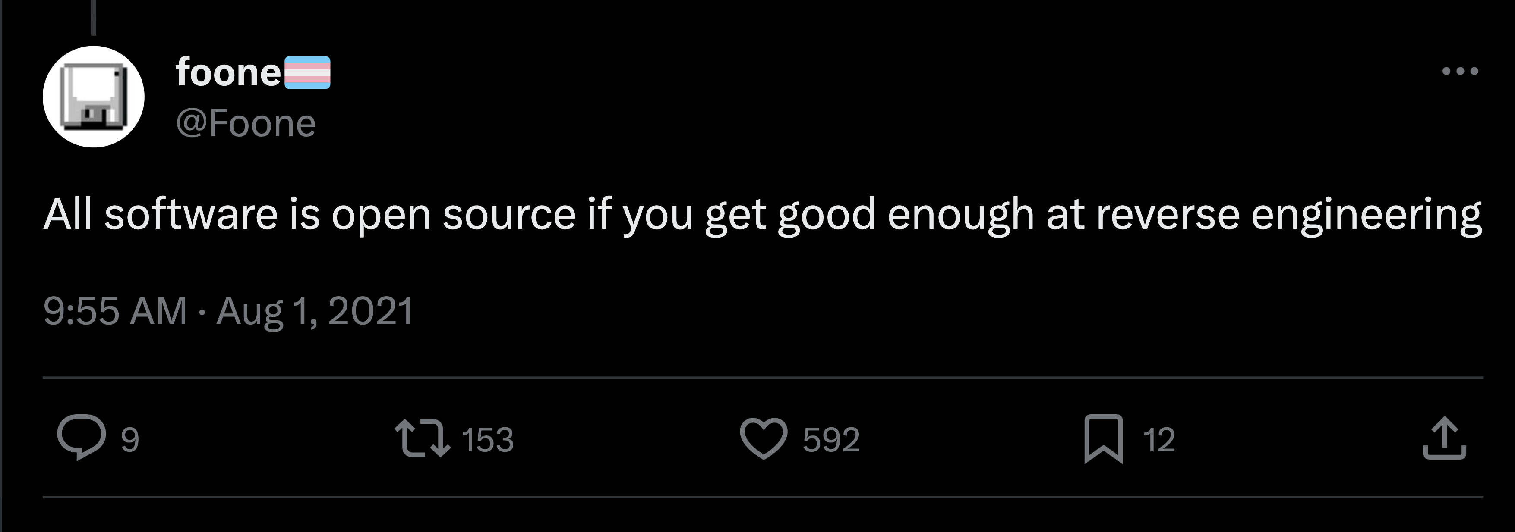
Reverse Engineering Web Apps
By Navpreet Singh Devpuri

Slide 2
Creativity Points and Connections
What is a Creativity Point?
What is a Creativity Connection?
A fundamental knowledge that can be utilized to solve problems.
A fundamental connections between creativity to form new creativity points that can be utilized to solve problems.

Slide 3
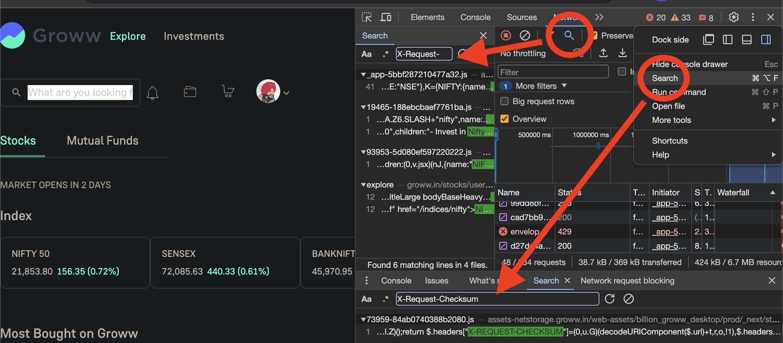
Creativity Point
Source Files & Network Calls searches

Slide 4
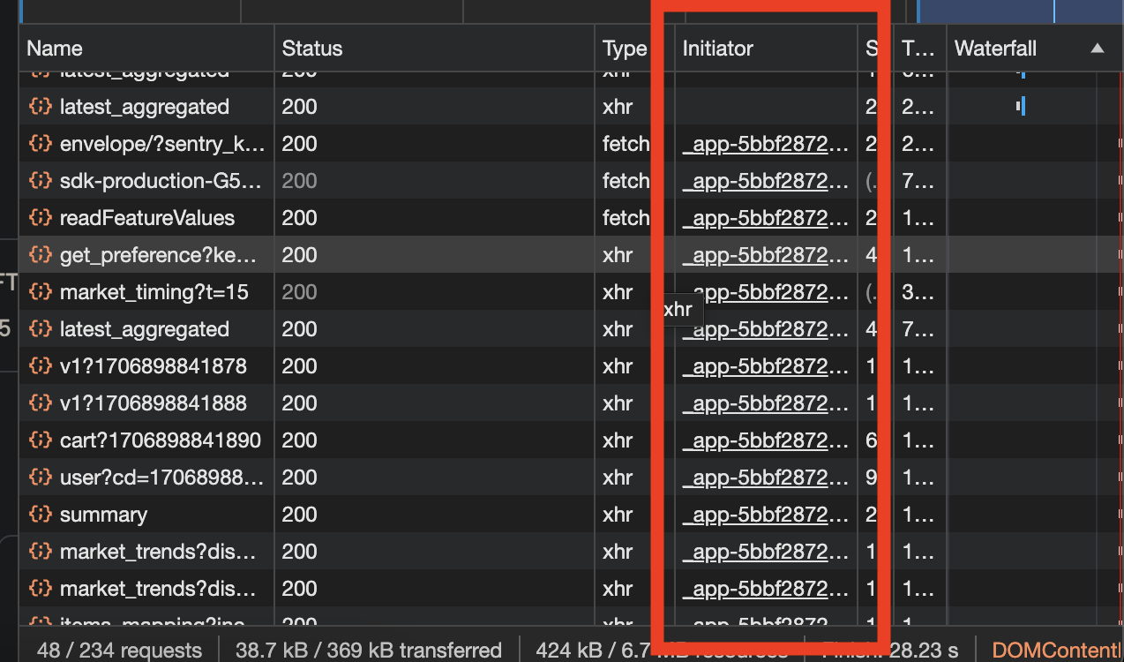
Creativity Point
Network Call’s function call stacks

Slide 5
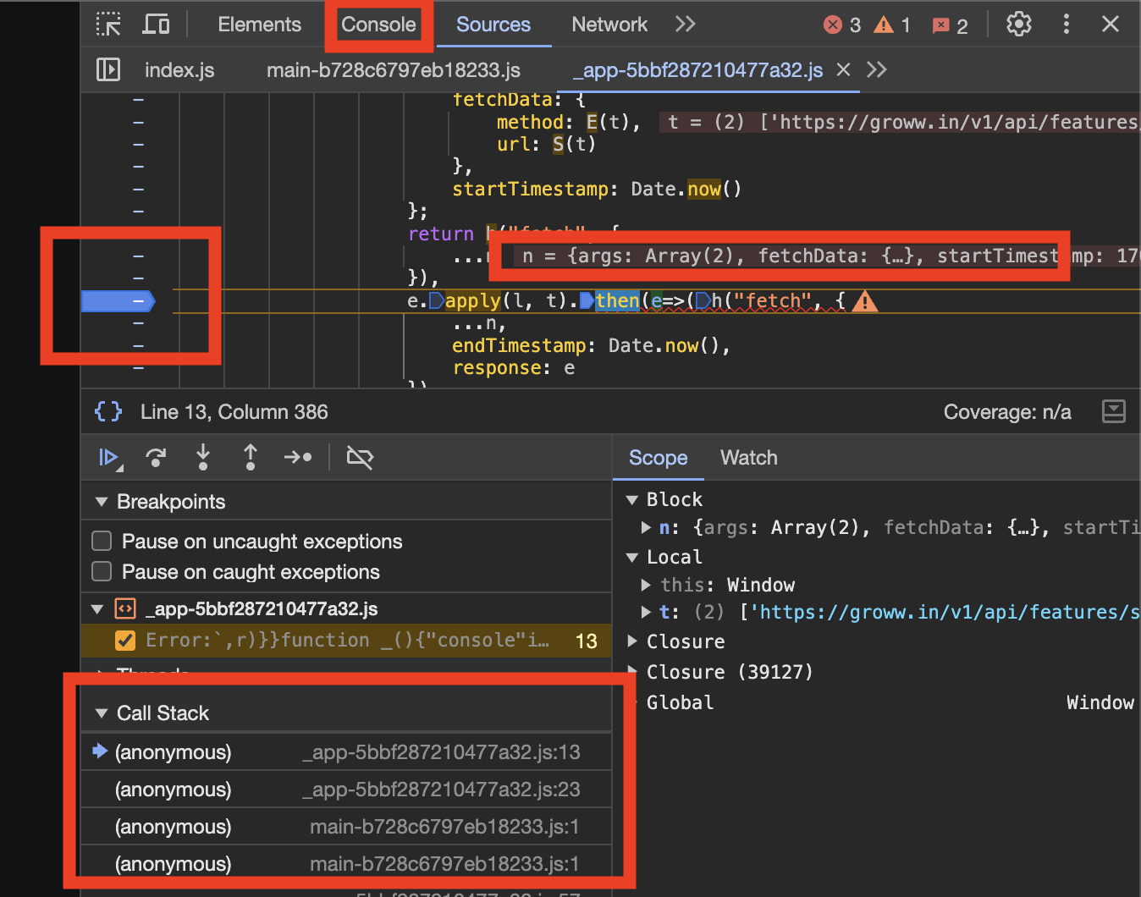
Creativity Point
Debugging with breakpoints. Check call stack!
Check variable values!
Run any code in Console!

Slide 6
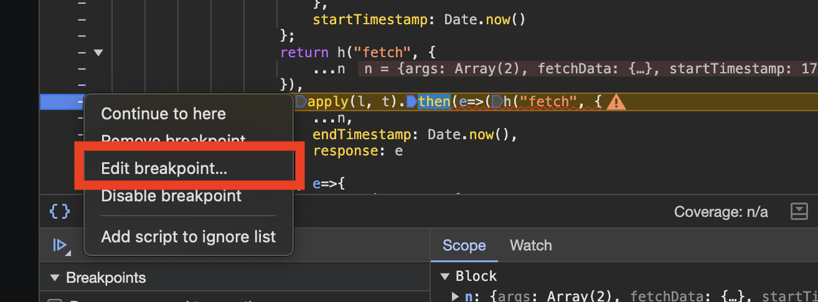
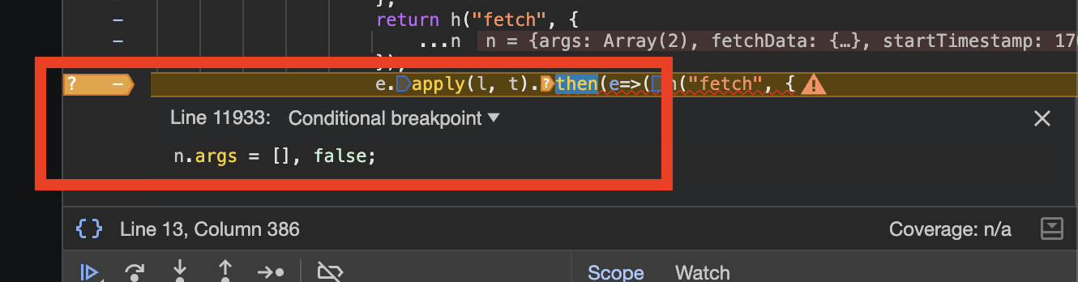
Creativity Point
Temporary Code Patching

Slide 7
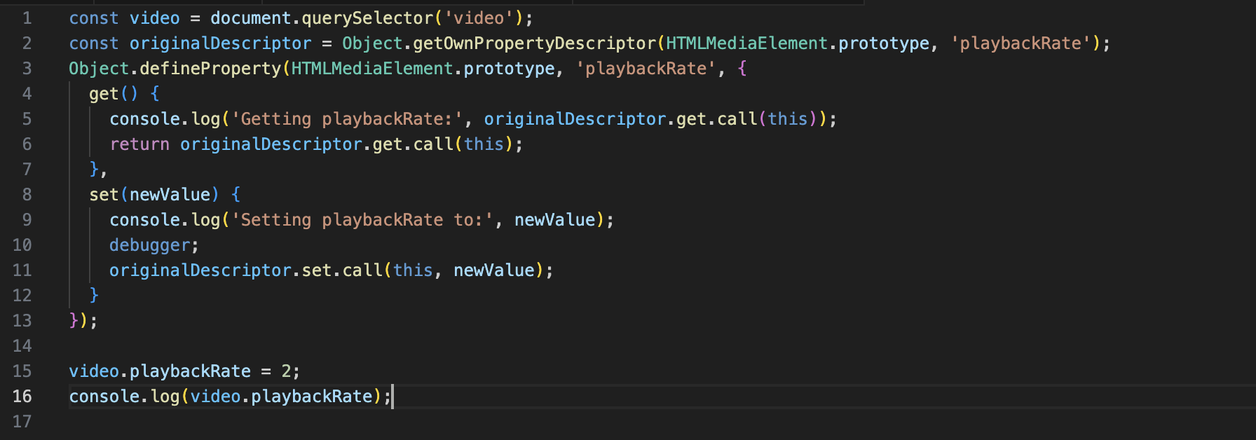
Creativity Point
Intercept JavaScript objects
Use “debugger” for breakpoint then check call stack to know from where something is changing.

Slide 8
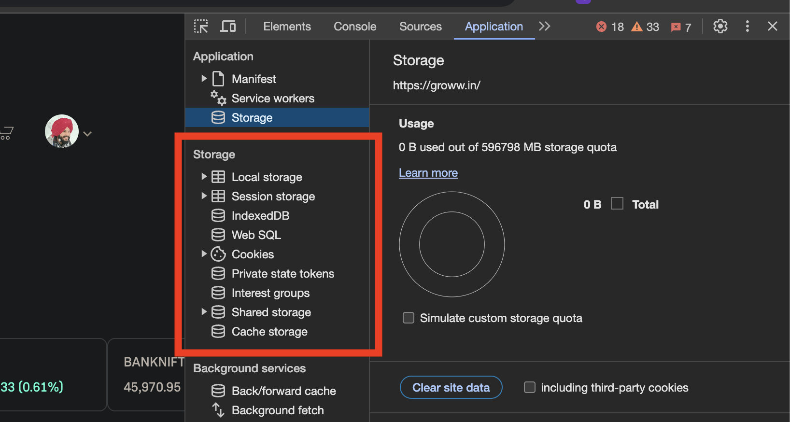
Creativity Point
Browser's Web Storages and Sessions

Slide 9
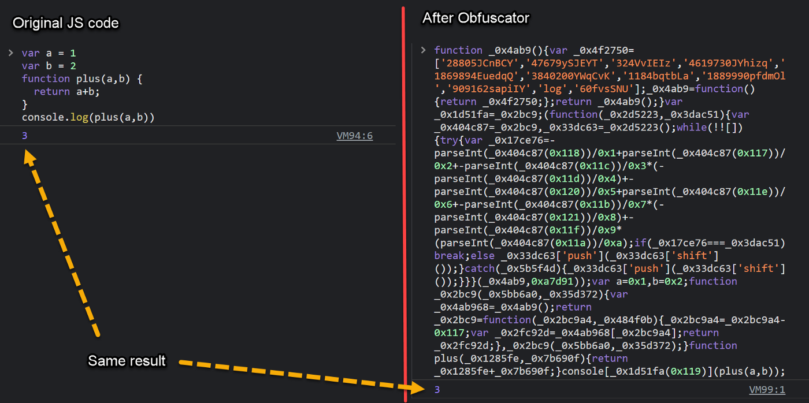
Creativity Point
De-obfuscation of Code

Slide 10
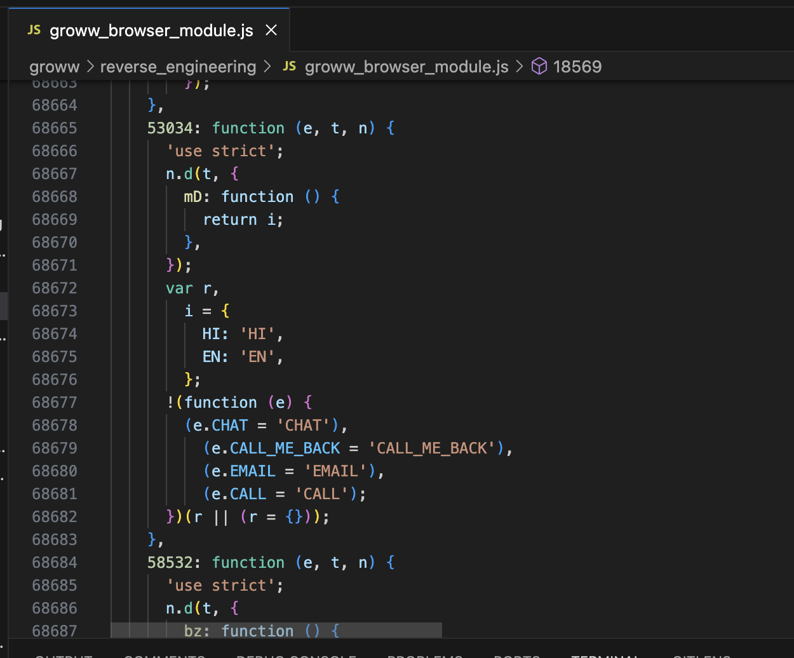
Creativity Point
Simplifying Compiled Code

Slide 11
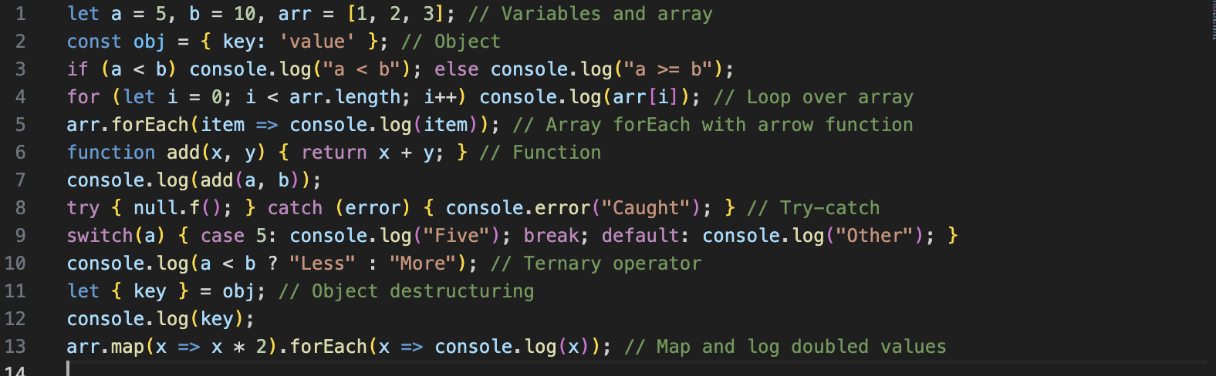
Creativity Point
Fundamentals of JavaScript

Slide 12
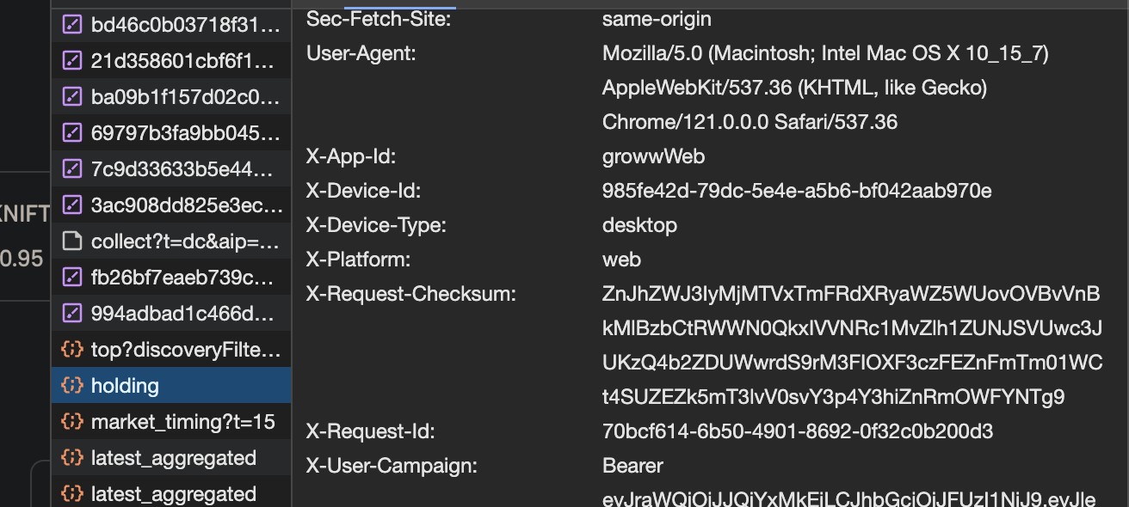
Creativity Connection
How does Session work for Groww?
Try removing storages like cookies or local storage.
Try removing headers.

Slide 13
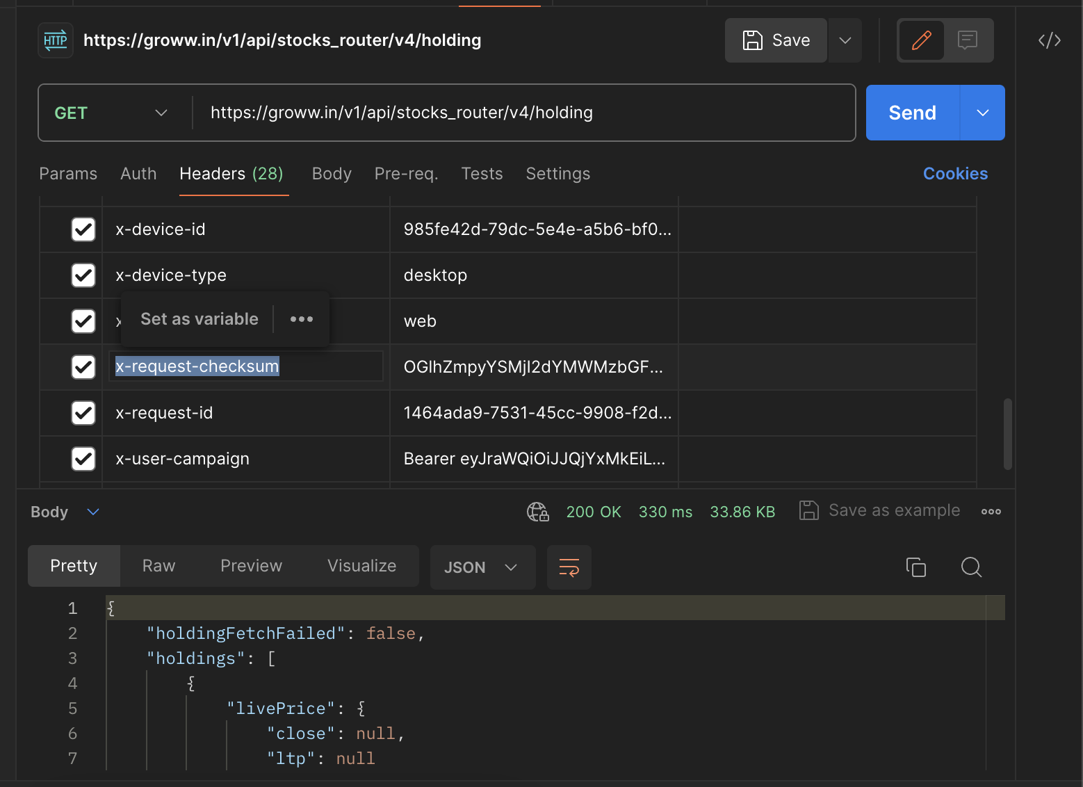
Creativity Connection
How API request works? Checksum!

Slide 14
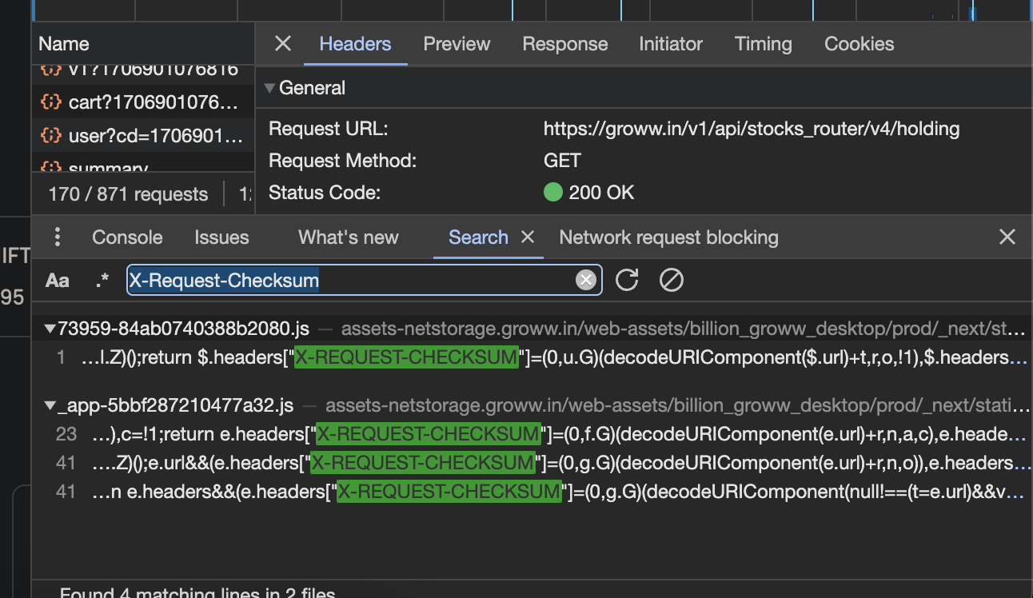
Creativity Connection
Where does Checksum is calculated?
Debug using breakpoints.

Slide 15
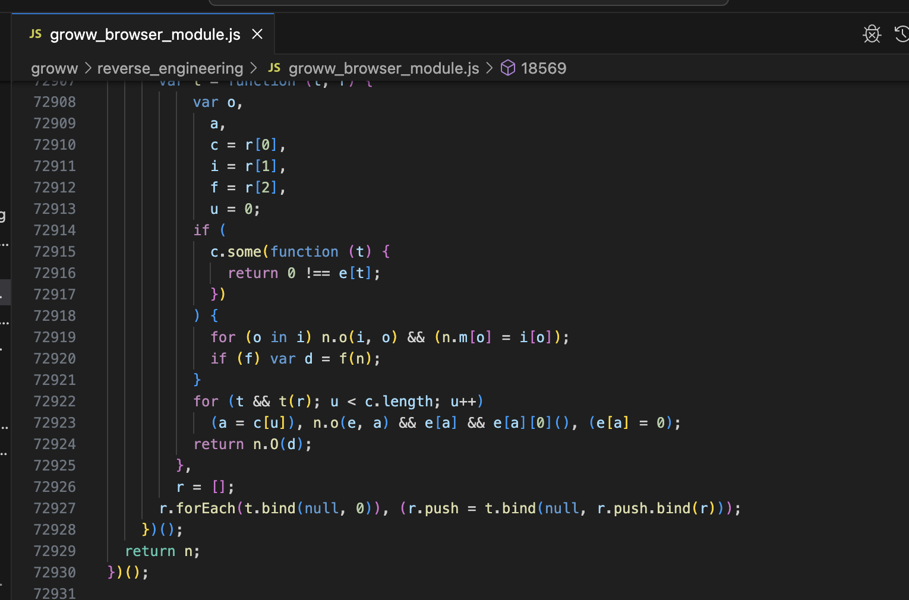
Creativity Connection
Almost 70k lines of code!? Compiled or Obfuscated?

Slide 16
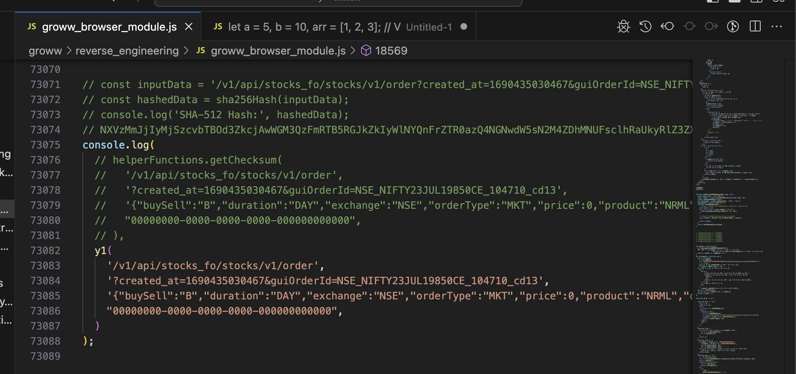
Creativity Connection
How can I make Checksum login work outside the browser? Make MVP.

Slide 17
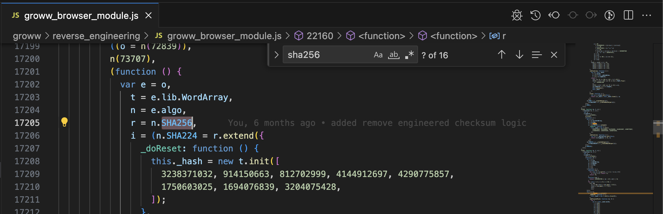
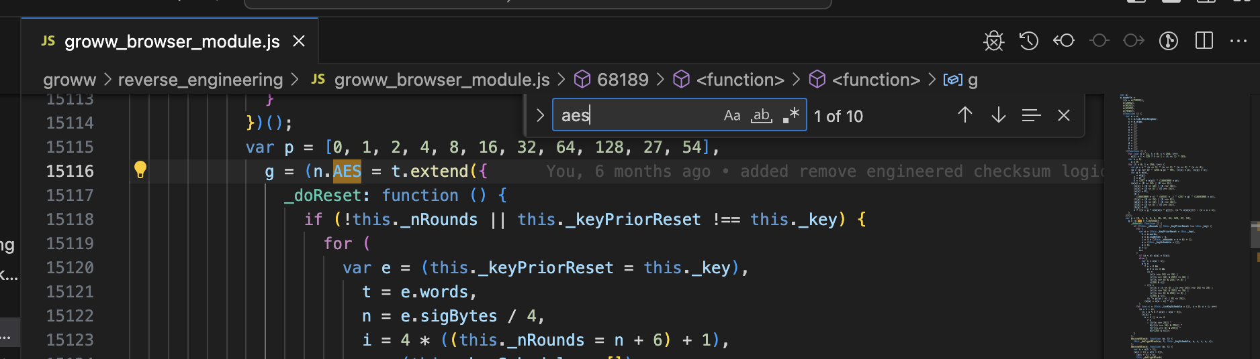
Creativity Connection
Found keyword like sha256 or AES!!
Hey, Chat GPT 4, What the heck is that?

Slide 18
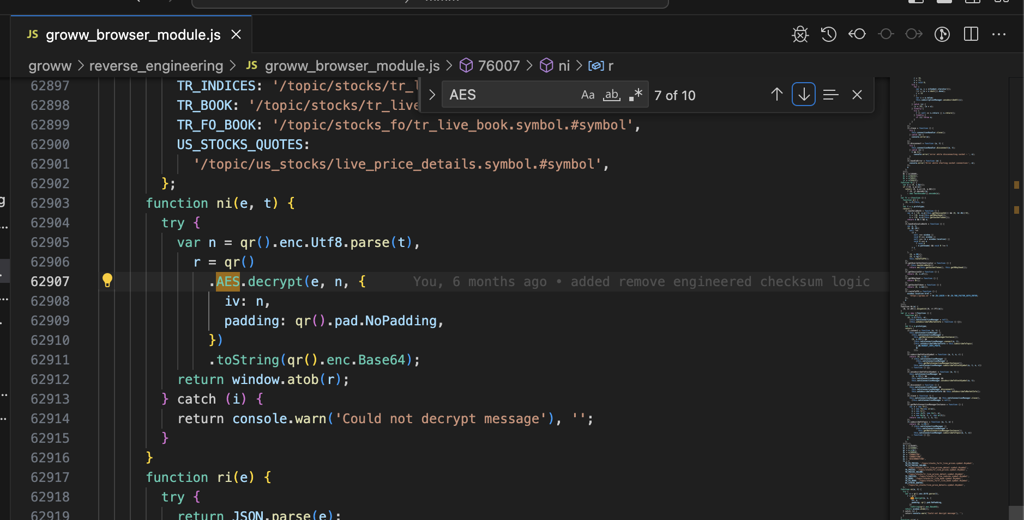
Creativity Connection
O god! around 30k lines of code is just for sha256 and AES!

Slide 19
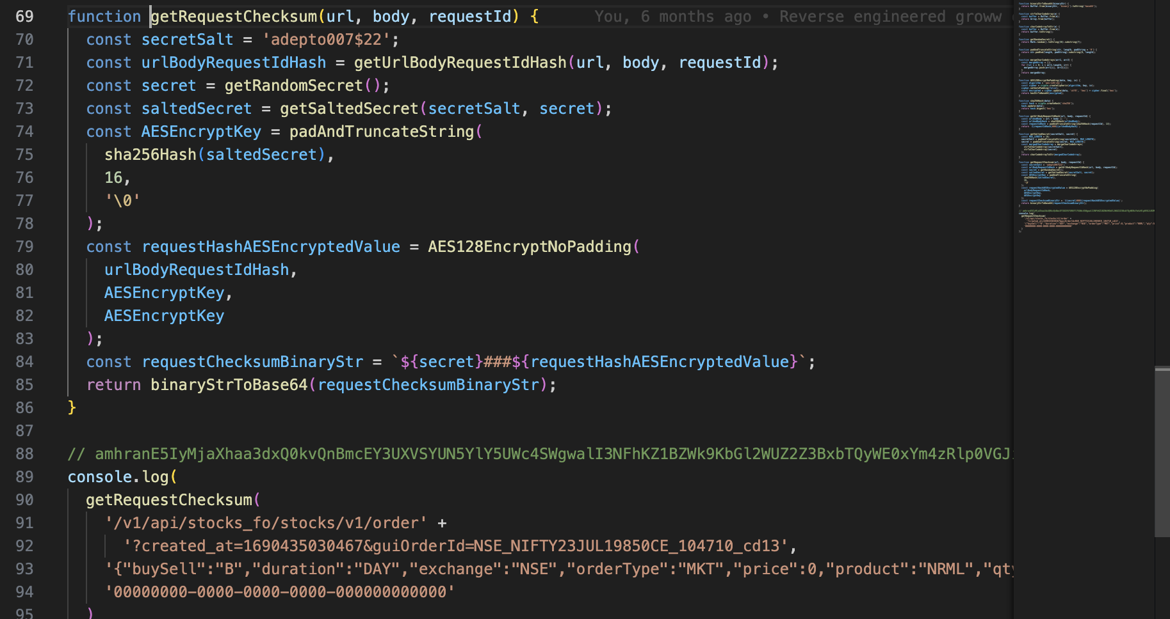
Creativity Connection
Final Code for Checksum 89 lines = 30,000 lines of compiled code.

Slide 20
Creativity Connection
Reversed Checksum logic! Collected APIs! Understood Session! Done! Ready to build unofficial Groww API

